Slide 1
HANDWRITTEN DIGIT RECOGNITION USING NEURAL NETWORKS
HANDWRITTEN DIGIT RECOGNITION USING NEURAL NETWORKS:
A Comparative Study: MNIST vs Custom Dataset
FINAL PROJECT PRESENTATION:
Neural Networks & Deep Learning Course

Slide 2
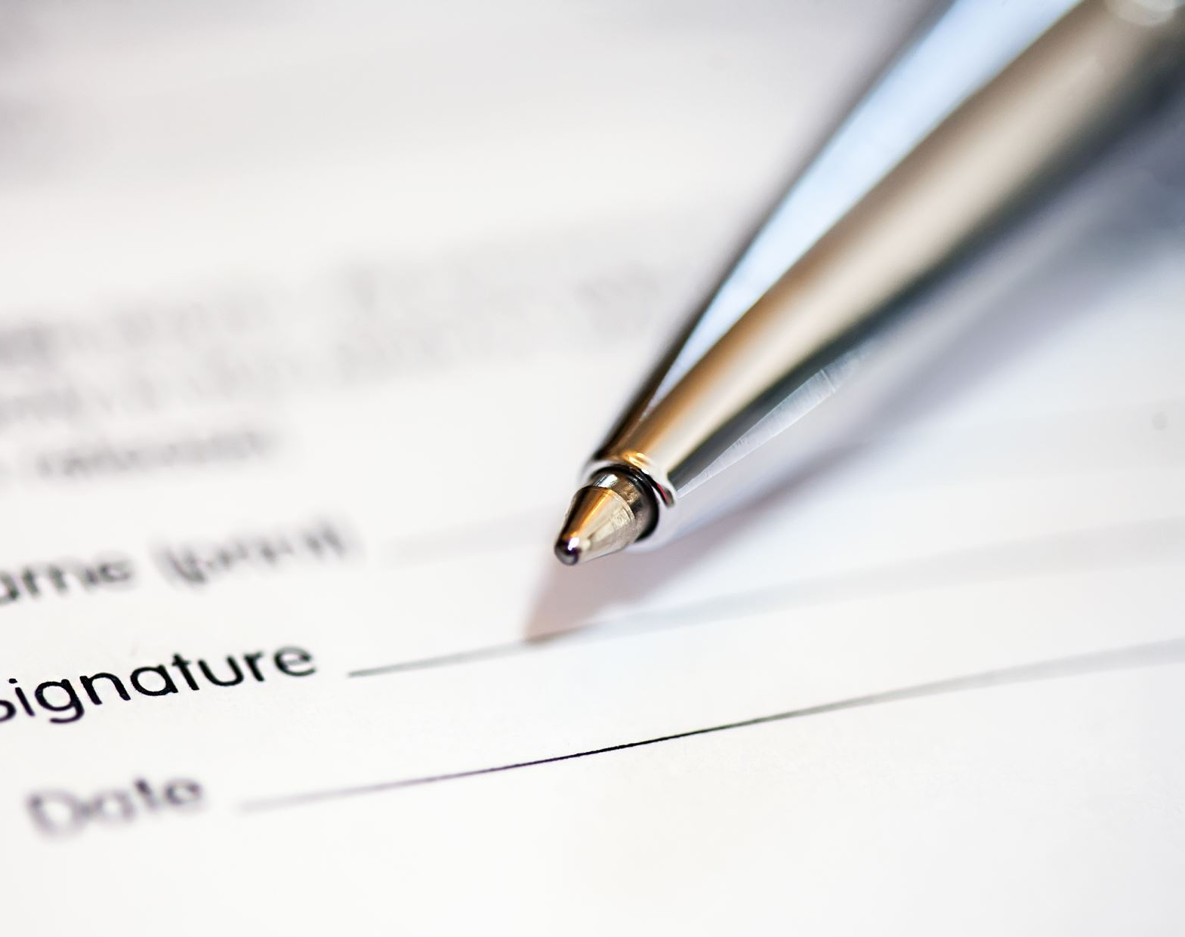
Problem Statement

Slide 3



The Challenge:
Manual digit recognition is slow, subjective, and error-prone
Need for automation in banking, postal services, and form processing
Inconsistency in human recognition of handwritten digits
What Problem Did We Solve?
Our Solution:
Automated digit recognition using Convolutional Neural Networks
Real-time processing with consistent results
High accuracy (99.03%) on standard benchmark data
Demonstrates practical AI application

Slide 4

Model Architecture

Slide 5
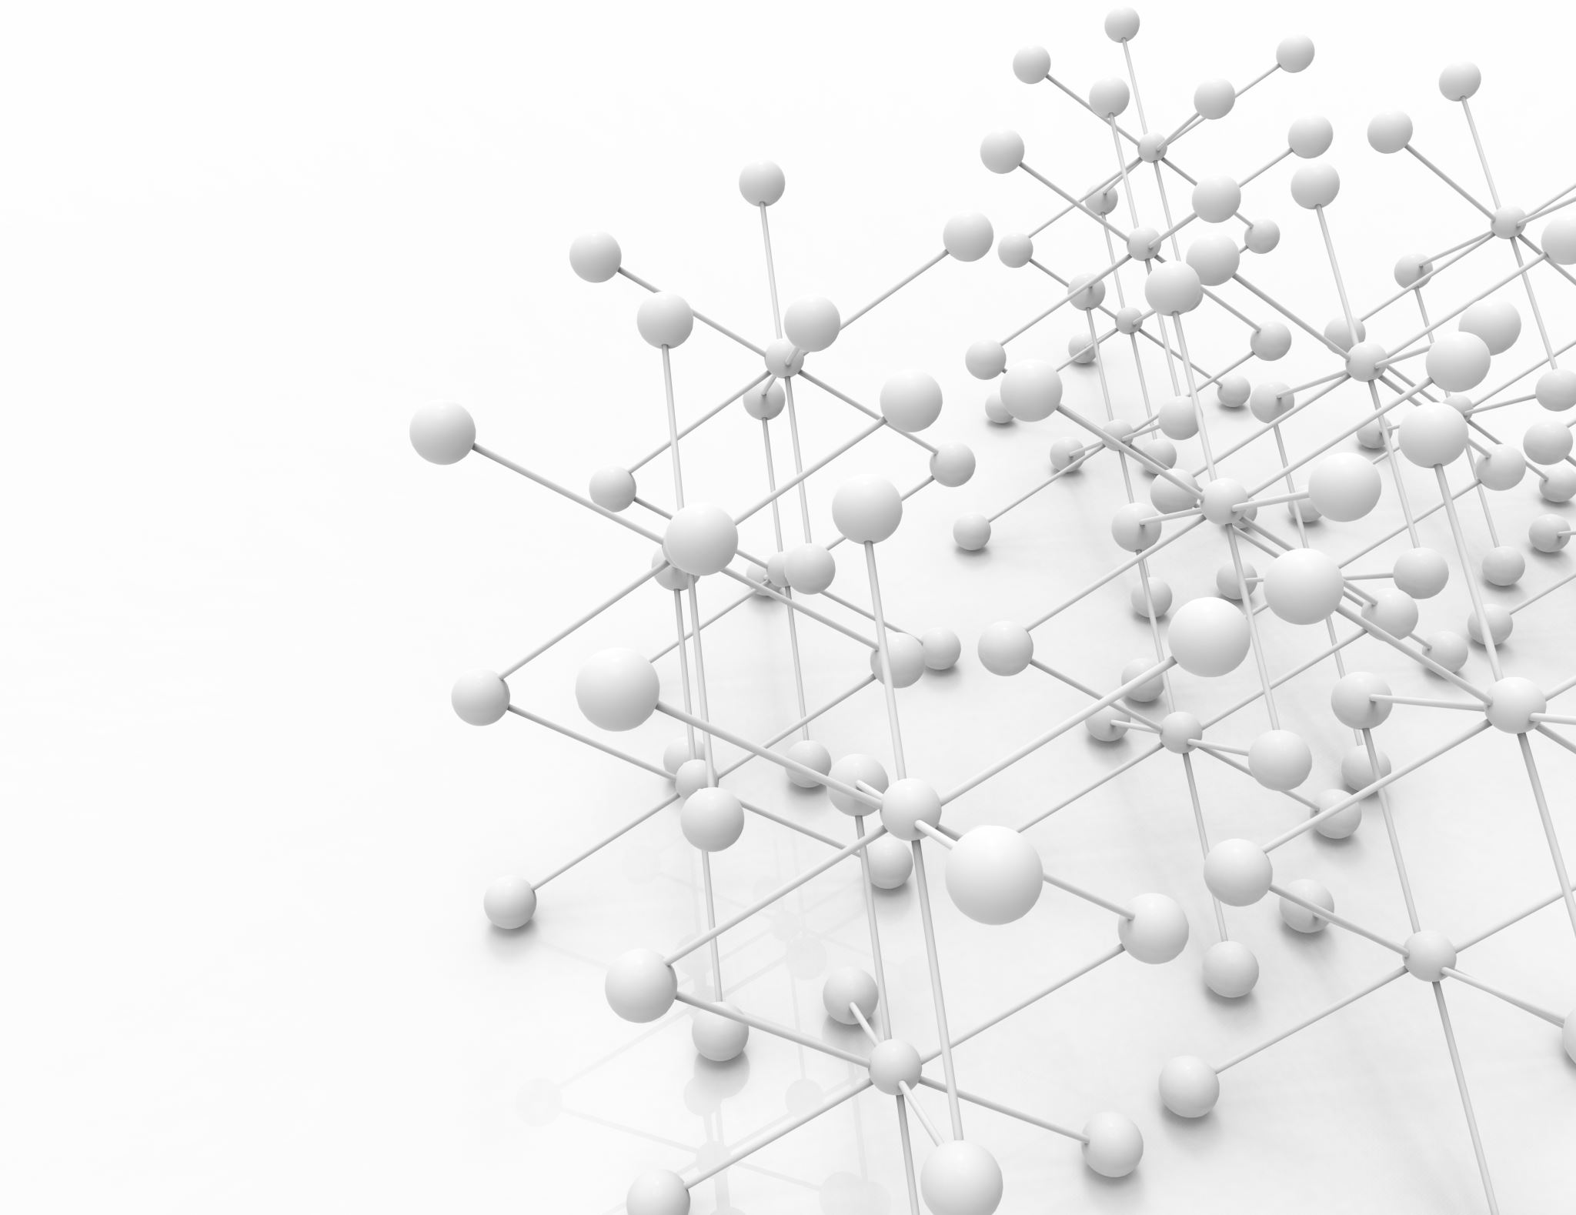
What Model Did We Use?
Neural Network Design:
Training Configuration:
Architecture: SimpleCNN (Convolutional Neural Network)
Input: 28×28 grayscale images (MNIST standard)
Layers: 2 Convolutional → 2 Pooling → 2 Fully Connected
Activation: ReLU (hidden layers), Softmax (output)
Parameters: 421,642 trainable weights
Optimizer: Adam with learning rate 0.001
Loss Function: Cross-Entropy Loss
Regularization: Dropout (30%)
Batch Size: 64 (MNIST), 32 (Custom)
Epochs: 10 (MNIST), 15 (Custom)

Slide 6
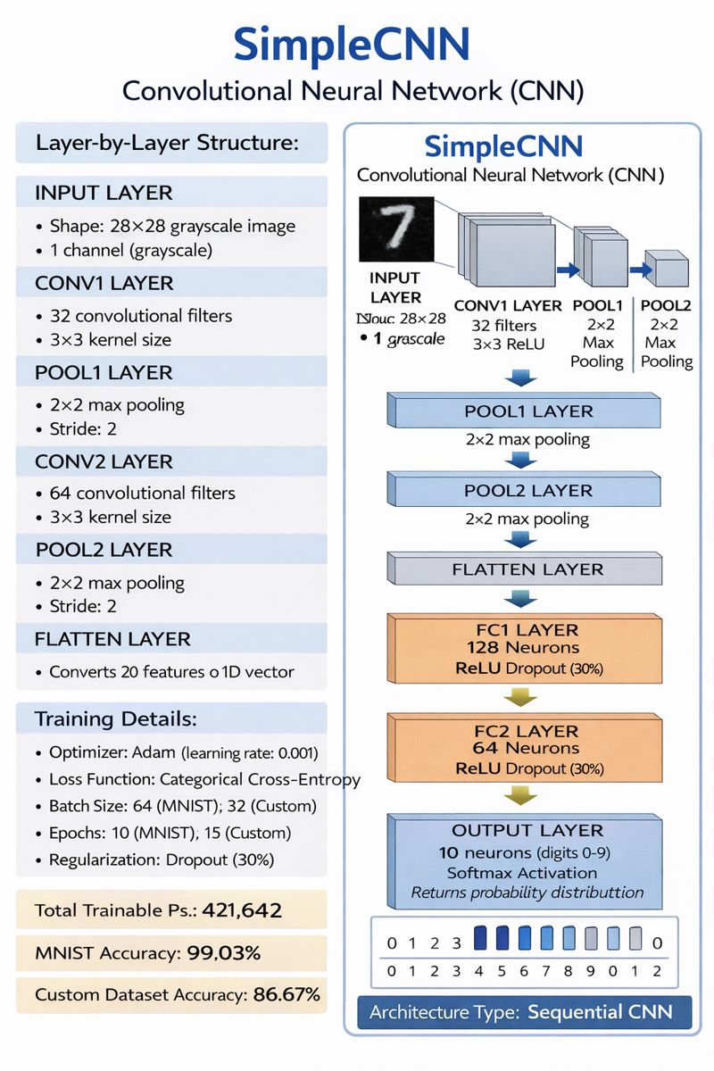

Slide 7

Training Performance

Slide 8


How Was the Model's Performance?
MNIST Dataset Results:
Training Accuracy: Started at 94.59% → Ended at 99.54%
Test Accuracy: 99.03% (9,903/10,000 correct)
Training Loss: Reduced from 0.1761 to 0.0138
Validation Accuracy: 99.17% (excellent generalization)
Custom Dataset Results:
Training Accuracy: Started at 15.64% → Ended at 95.50%
Test Accuracy: 86.67% (260/300 correct)
Training Loss: Reduced from 2.2687 to 0.1512
Significant learning from limited data (2,000 samples)

Slide 9

Dataset Comparison

Slide 10
MNIST vs Custom Dataset Analysis
MNIST Dataset (Standard):
Samples: 70,000 total (60,000 "48,000 train + 12,000 validation" + 10,000 test)
Quality: Clean, centered, standardized digits
Variation: Consistent writing styles
Purpose: Benchmark for digit recognition
Custom Dataset (Our Collection):
Samples: 2000 total handwritten digits​
Quality: Varied lighting, backgrounds, and styles​
Variation: Diverse personal handwriting​
Challenge: Real-world complexity​
​
Accuracy Comparison:
MNIST Model: 99.22% accuracy​
Custom Model: 86.67% accuracy​
Accuracy Gap: 12.36% difference

Slide 11
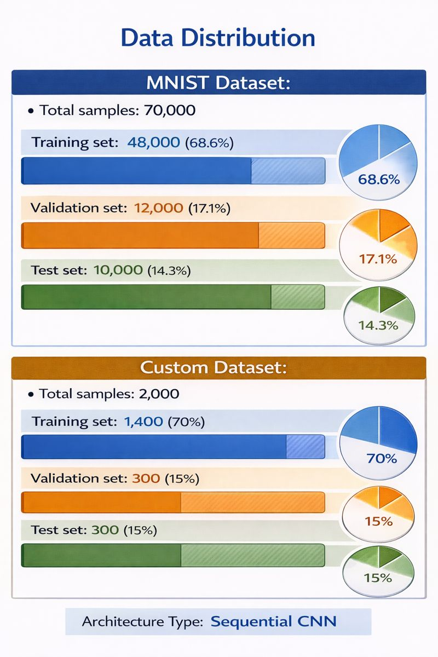

Slide 12
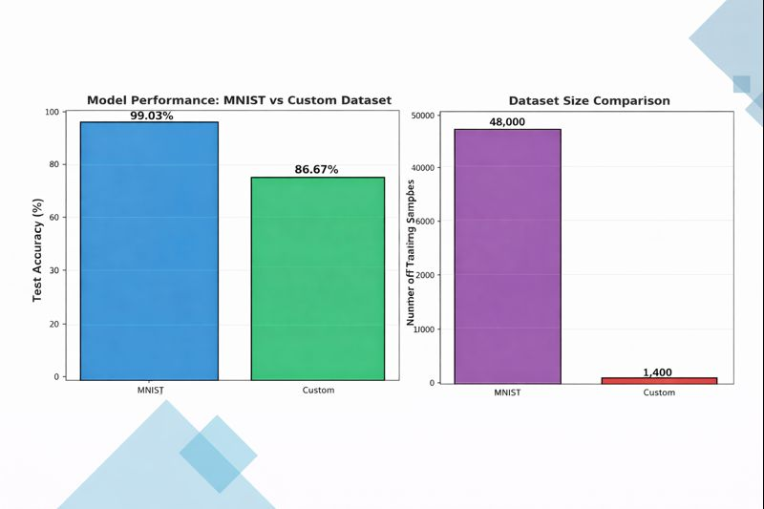

Slide 13

Visual Results

Slide 14

Performance Visualization:
Comparison Chart:
Side-by-side accuracy comparison
MNIST (99.23%) vs Custom (86.67%)
Clear visualization of performance gap
Confusion Matrices:
MNIST: Near-perfect diagonal pattern
Custom: Good recognition with some confusion
Most confused pairs: 3↔8, 5↔6
Best recognized: Digits 0, 1, 7
Training History Graphs:
Accuracy progression over epochs
Loss reduction patterns
Validation performance tracking

Slide 15
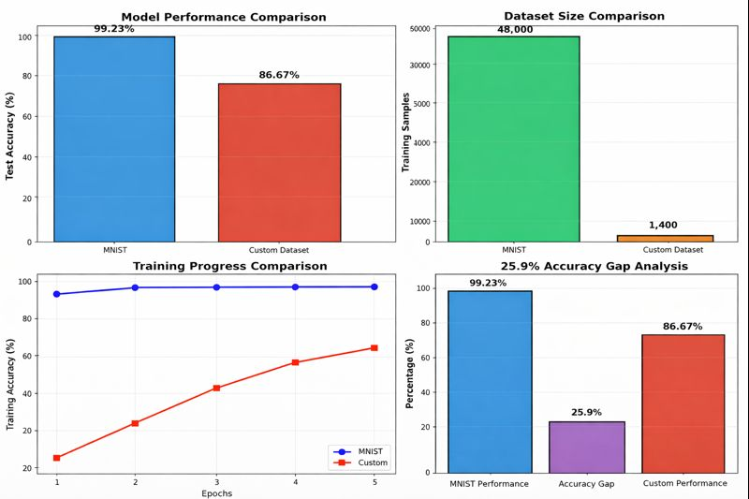

Slide 16
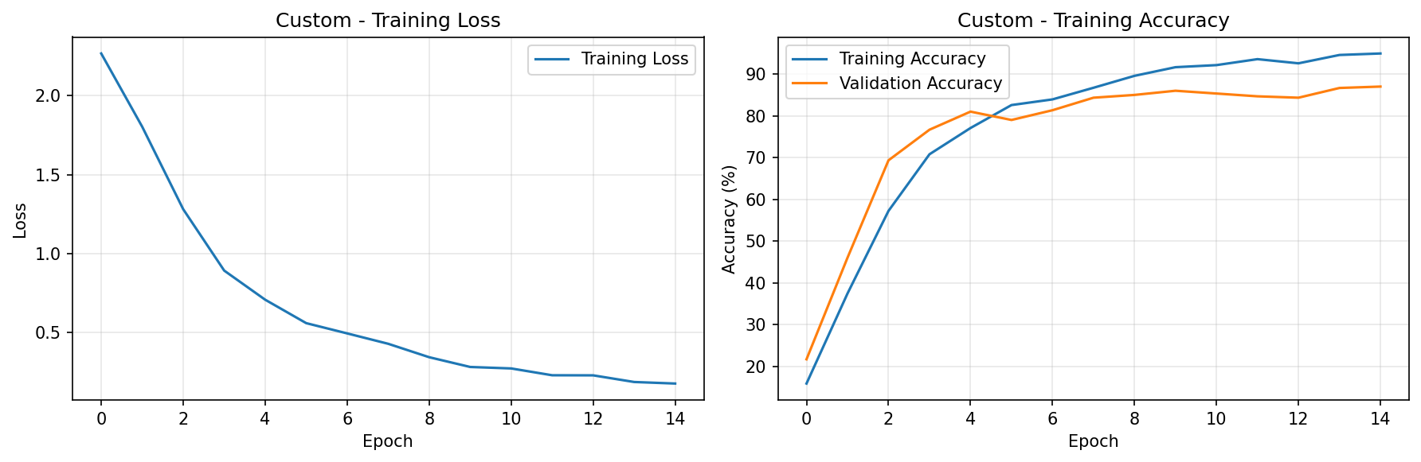
CUSTOM DATASET

Slide 17
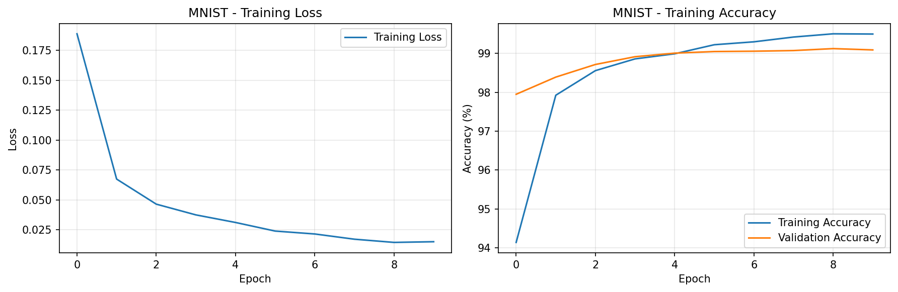
MNIST DATASET

Slide 18
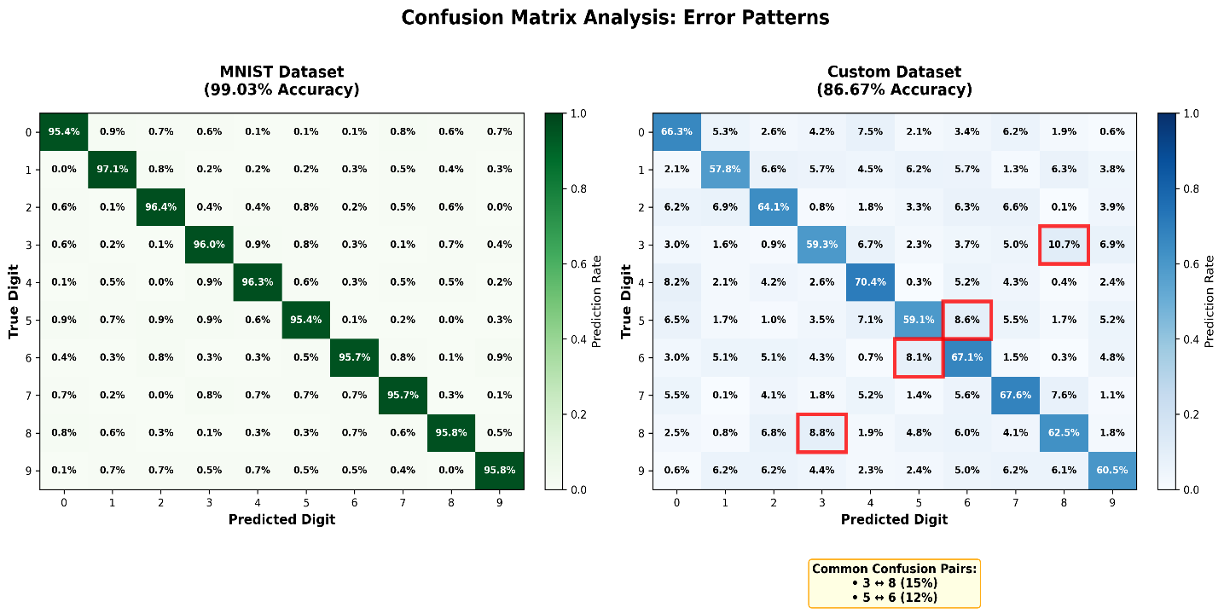
CONFUSION MATRIX

Slide 19

Interactive GUI Application

Slide 20

Real-Time Testing Tool
Features Implemented:
1.Dual Model Testing:
Compare MNIST and Custom models simultaneously
Visual side-by-side comparison
2.Multiple Input Methods:
Upload image files (PNG, JPG, BMP)
Draw digits in real-time canvas
Test with sample digits (0-9 buttons)
3.Detailed Results Display:
Confidence scores with color coding
Probability distribution charts
Model agreement/disagreement indicators
Export functionality for results

Slide 21

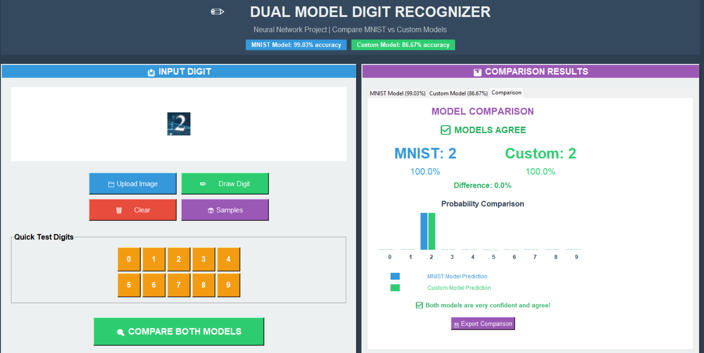

Slide 22

Challenges Encountered

Slide 23

What Were the Main Challenges?
Data-Level Challenges:
1.Dataset Size Imbalance
MNIST: 60,000 training samples
Custom: Only 1,400 training samples (35:1 ratio)
2.Quality Variations:
Different handwriting styles
Varied lighting conditions
Inconsistent backgrounds
3.Style Differences:
MNIST: Standardized, clean digits
Custom: Natural, varied handwriting
4.Model Performance Gap:
12.36% accuracy difference between models
Shows real-world deployment challenges

Slide 24

Improvement Methods

Slide 25
What Methods for Improvement?
Proposed Solutions:
1.Data Augmentation (Immediate):
3.Dataset Expansion (Long-term):
Rotation (±15 degrees)
Scaling (90-110%)
Add random noise
Brightness/contrast adjustment
Collect more handwritten samples
Target: 5,000-10,000 custom samples
Ensure diversity in writing styles
2.Transfer Learning (Medium-term):
4.Advanced Architectures:
Use MNIST-trained weights as starting point
Fine-tune on custom data
Freeze early layers, train later layers
ResNet with skip connections
DenseNet for feature reuse
Attention mechanisms
Expected Outcomes:
Reduce accuracy gap to <5%
Achieve >95% accuracy on custom data
Better generalization to real handwriting

Slide 26
Conclusion & Future Work

Slide 27
Key Takeaways & Next Steps
Project Achievements:
✅ Successfully implemented CNN for digit recognition
✅ Achieved 99.03% accuracy on MNIST benchmark
✅ Trained custom model achieving 86.67% accuracy
✅ Developed interactive GUI for testing
✅ Demonstrated real-world AI application
Future Work:
Implement data augmentation techniques
Apply transfer learning approach
Expand custom dataset collection
Deploy as web/mobile application
Extend to multi-digit recognition
Technical Contributions:
Complete neural network implementation
Comparative analysis framework
GUI application with visualization
Model evaluation and improvement strategies

Slide 28

LIVE DEMO

Slide 29
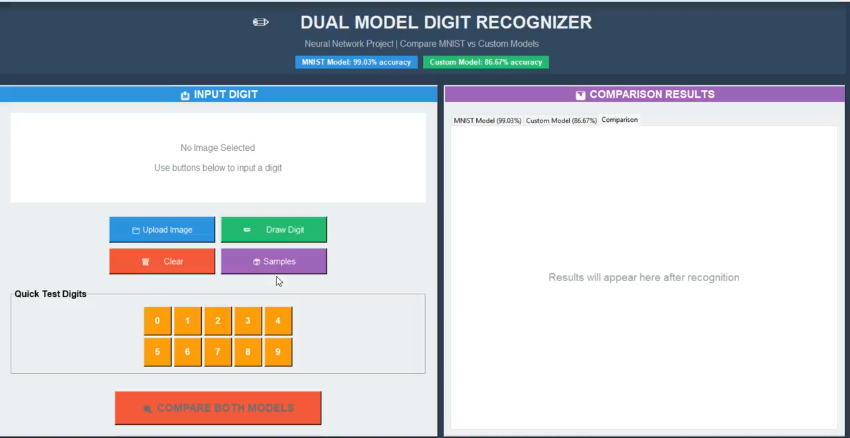

Slide 30

THANKYOU

